Slide 1

DSF - Group 4 Presentation
29th Jan 2024

Slide 2
Introduction

Slide 3
Objectives
1
Identify Demographic Trends
Explore and analyze demographic factors such as age, gender, marital status, and residence type to identify any trends or patterns related to strokes.
Assess Health Metrics Impact
Investigate the impact of health metrics, including hypertension, heart disease, average glucose level, and BMI, on the occurrence of strokes.
Evaluate Lifestyle Factors
Examine lifestyle factors, specifically smoking status and work type, to understand their association with strokes.
Explore Correlations
Conduct correlation analysis to identify relationships between different health conditions (hypertension, heart disease) and understand their potential collective influence on strokes.

Slide 4
Steps
2
Data Loading
Data Inspection
Data Cleaning
Exploratory Data Analysis (EDA):
Summary and Reporting

Slide 5
Summary and Insights

Slide 6
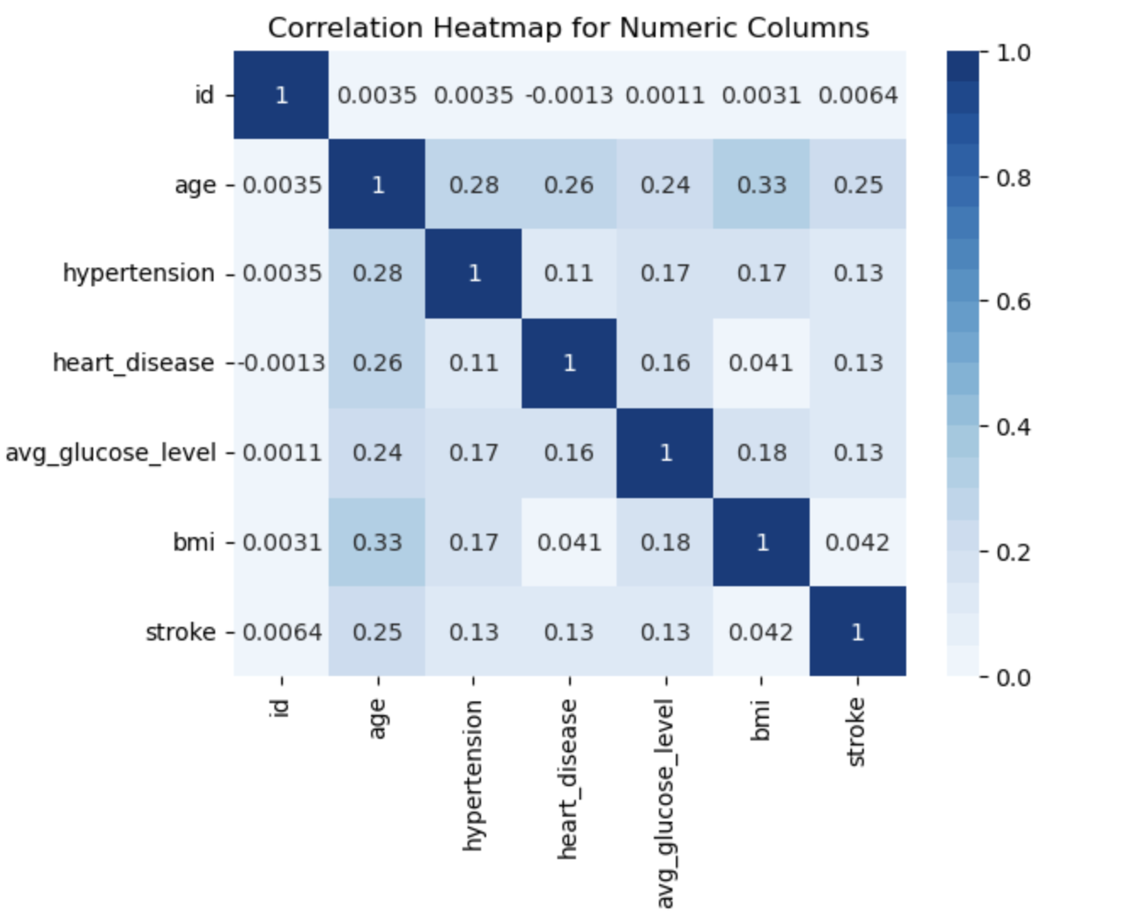
Correlation - Numeric Columns
5

Slide 7
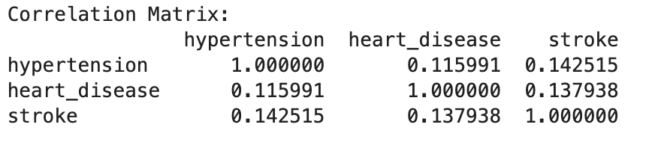
Correlation Matrix
5

Slide 8
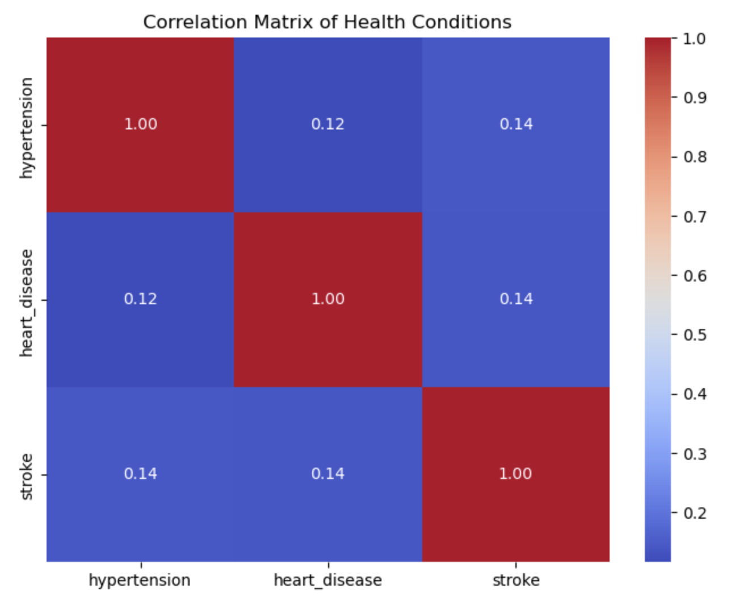
Correlation Matrix
5

Slide 9
Correlation Interpretation
6
Hypertension and Stroke: 0.14
There is a weak correlation between hypertension and stroke
It is unlikely for hypertension to cause stroke
Heart disease and Stroke: 0.137 ~ 0.14
There is weak association between heart disease and stroke
Patients with heart disease are not likely to get a stroke
Glucose level and Stroke: ~ 0.13
There is weak association between glucose levels and stroke
Patients with high glucose levels are not likely to get a stroke
Age vs Stroke: 0.25
The association between stroke and age is relatively high
Older people are more likely to get a stroke.
NB: The age is -vely skewed - most of participants we older

Slide 10
Correlation Interpretation
6
BMI and Stroke: 0.042
There is almost no correlation between BMI and stroke
BMI indicates if a patient is overweight, underweight or healthy weight ranges
Smoking and Stroke
5.3% of participants who smoked had a stroke
4.54% of participants who did not smoke had a stroke
6.81% of participants who formerly smoked had a stroke
1.96 whose smoking status was unknown had a stroke
We can conclude that smoking might increase risk of stroke but not strongly correlated.

Slide 11
Correlation Interpretation
6
Work Type vs Stroke:
4.4% of those worked with government had a stroke
Nobody who never worked had a stroke
4.58% of privately employed had a stroke
6.84 of self employed had a stroke and
Only 0.15 children had a stroke - not working
We can conclude from the correlation that those who are in private institutions are more likely to suffer from strokes.
But from the % above, a higher % of self-employed participants suffered a stroke
We need to investigate if they had any underlying conditions before concluding that work-type affects likelihood of getting a stroke

Slide 12
Recommendations

Slide 13
Recommendations
6
Older people should get check up regularly to avoid getting strokes.
Though there is less correlation between hypertension, heart disease and stroke, patients with existing health conditions, should consider regular checkups.
Patients with underlying conditions to avoid smoking as slightly high percentage of people who smoked or formerly smoked had a stroke compared to those you do not smoke.

Slide 14
Group 4 Presentation

